Slide 1

RANDOM NUMBERS

Slide 2
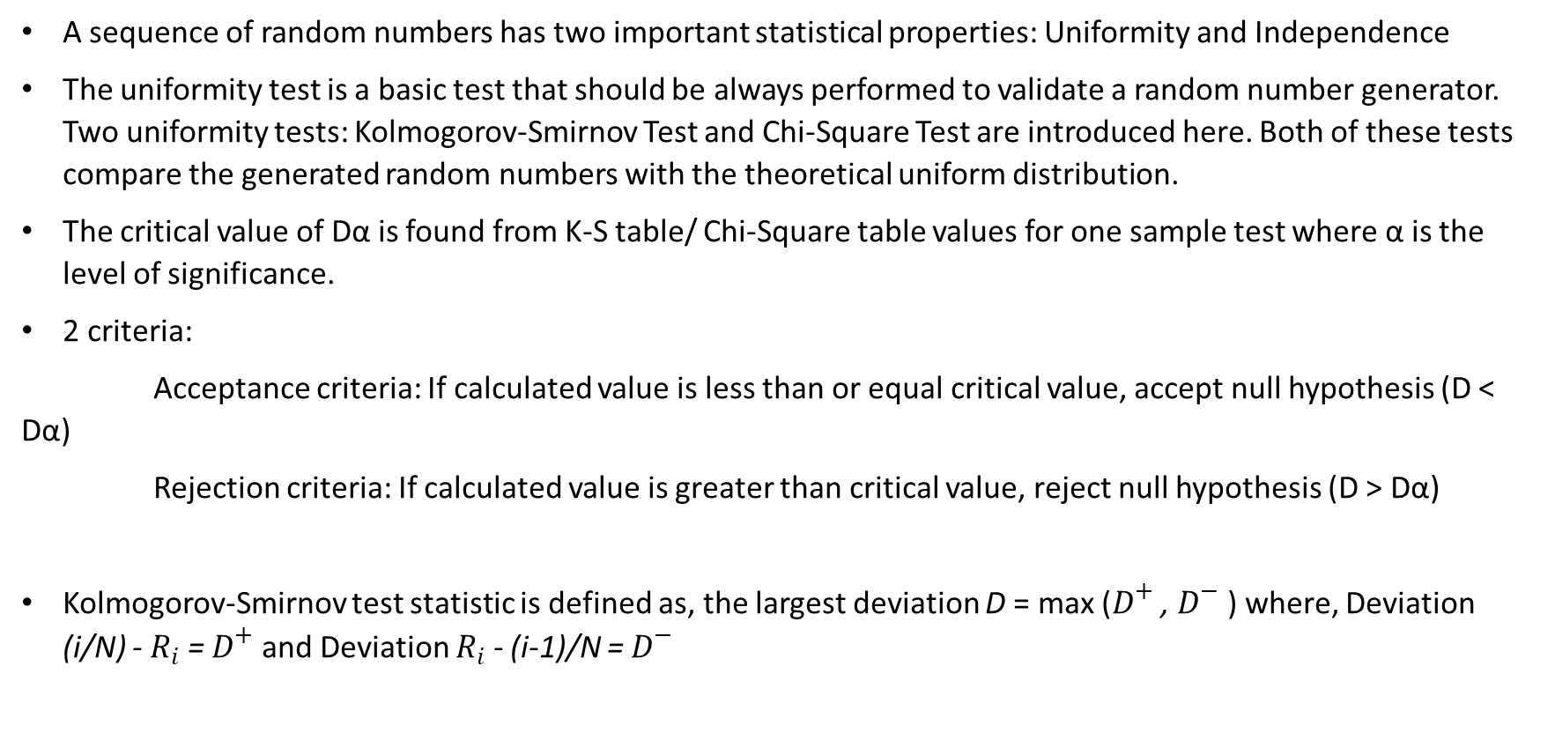
RANDOM NUMBERS
A sequence of random numbers has two important statistical properties: Uniformity and Independence
The uniformity test is a basic test that should be always performed to validate a random number generator. Two uniformity tests: Kolmogorov-Smirnov Test and Chi-Square Test are introduced here. Both of these tests compare the generated random numbers with the theoretical uniform distribution.
The critical value of Dα is found from K-S table/ Chi-Square table values for one sample test where α is the level of significance.
2 criteria:
Acceptance criteria: If calculated value is less than or equal critical value, accept null hypothesis (D < Dα)
Rejection criteria: If calculated value is greater than critical value, reject null hypothesis (D > Dα)
Kolmogorov-Smirnov test statistic is defined as, the largest deviation D = max ($D^{+}$ , $D^{−}$ ) where, Deviation (i/N) - $R_{i}$ = $D^{+}$ and Deviation $R_{i}$ - (i-1)/N = $D^{−}$

Slide 3
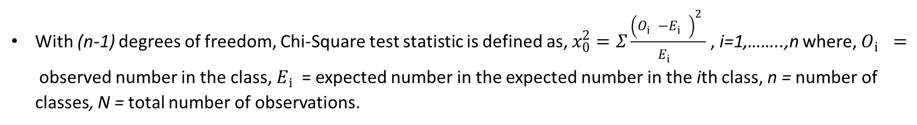
RANDOM NUMBERS
With (n-1) degrees of freedom, Chi-Square test statistic is defined as, $x_{0}^{2}=Σ\frac{{\left(O_{i}^{}−E_{i}^{}\right)}_{}^{2}}{E_{i}^{}}$ , i=1,……..,n where, $O_{i}^{}=$observed number in the class, $E_{i}^{}$= expected number in the expected number in the ith class, n = number of classes, N = total number of observations.

Slide 4
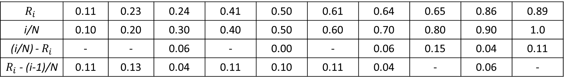
RANDOM NUMBERS
QUESTION - 1
Perform the Kolmogorov-Smirnov Test to test the uniformity of the following random numbers with a level of significance of α = 0.05
0.24, 0.89, 0.11, 0.61, 0.23, 0.86, 0.41, 0.64, 0.50, 0,65
ANSWER
Here, total count of random number, N = 10 and arranging the random numbers in ascending order we get,
0.11, 0.23, 0.24, 0.41, 0.50, 0.61, 0.64, 0.65, 0.86, 0.89
$$R_{i}$$ | 0.11 | 0.23 | 0.24 | 0.41 | 0.50 | 0.61 | 0.64 | 0.65 | 0.86 | 0.89
i/N | 0.10 | 0.20 | 0.30 | 0.40 | 0.50 | 0.60 | 0.70 | 0.80 | 0.90 | 1.0
(i/N) - $R_{i}$ | - | - | 0.06 | - | 0.00 | - | 0.06 | 0.15 | 0.04 | 0.11
$R_{i}$ - (i-1)/N | 0.11 | 0.13 | 0.04 | 0.11 | 0.10 | 0.11 | 0.04 | - | 0.06 | -

Slide 5
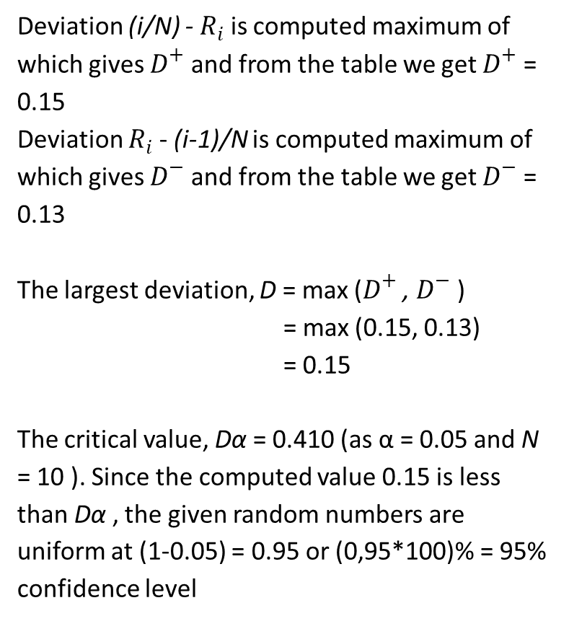
RANDOM NUMBERS
Deviation (i/N) - $R_{i}$ is computed maximum of which gives $D^{+}$ and from the table we get $D^{+}$ = 0.15
Deviation $R_{i}$ - (i-1)/N is computed maximum of which gives $D^{−}$ and from the table we get $D^{−}$ = 0.13
The largest deviation, D = max ($D^{+}$ , $D^{−}$ )
= max (0.15, 0.13)
= 0.15
The critical value, Dα = 0.410 (as α = 0.05 and N = 10 ). Since the computed value 0.15 is less than Dα , the given random numbers are uniform at (1-0.05) = 0.95 or (0,95*100)% = 95% confidence level
Kolmogorov-Smirnov Critical Values
Degrees of freedom | α = 0.10 | α = 0.05
1 | 0.950 | 0.975
2 | 0.776 | 0.842
3 | 0.642 | 0.708
4 | 0.564 | 0.624
5 | 0.510 | 0.565
6 | 0.470 | 0.521
7 | 0.438 | 0.486
8 | 0.411 | 0.457
9 | 0.388 | 0.432
10 | 0.368 | 0.410
11 | 0.352 | 0.391
12 | 0.338 | 0.375
13 | 0.325 | 0.361
14 | 0.314 | 0.349

Slide 6
RANDOM NUMBERS
QUESTION - 2
Perform the Chi-Square Test to test the uniformity of the following 100 random numbers. Is it acceptable at 95% confidence level?
10 | 29 | 32 | 50 | 59 | 36 | 80 | 45 | 24 | 07
25 | 08 | 76 | 90 | 61 | 58 | 98 | 74 | 08 | 30
35 | 97 | 11 | 85 | 77 | 81 | 90 | 17 | 70 | 57
54 | 78 | 82 | 09 | 40 | 33 | 15 | 89 | 80 | 60
35 | 65 | 95 | 73 | 06 | 13 | 55 | 91 | 88 | 39
41 | 52 | 83 | 37 | 07 | 15 | 38 | 72 | 99 | 50
75 | 81 | 47 | 05 | 14 | 22 | 02 | 60 | 86 | 96
93 | 77 | 18 | 51 | 40 | 31 |  | 05 | 66 | 79
27 | 03 | 51 | 84 | 91 | 71 | 57 | 87 | 20 | 28
04 | 26 | 64 | 33 | 55 | 53 | 49 | 37 | 22 | 01

Slide 7
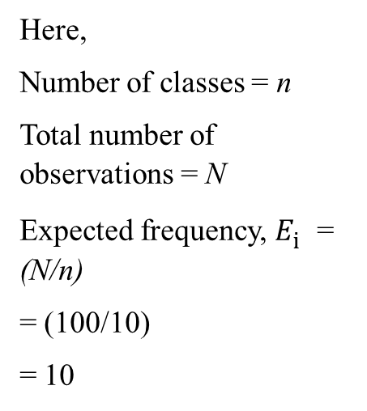
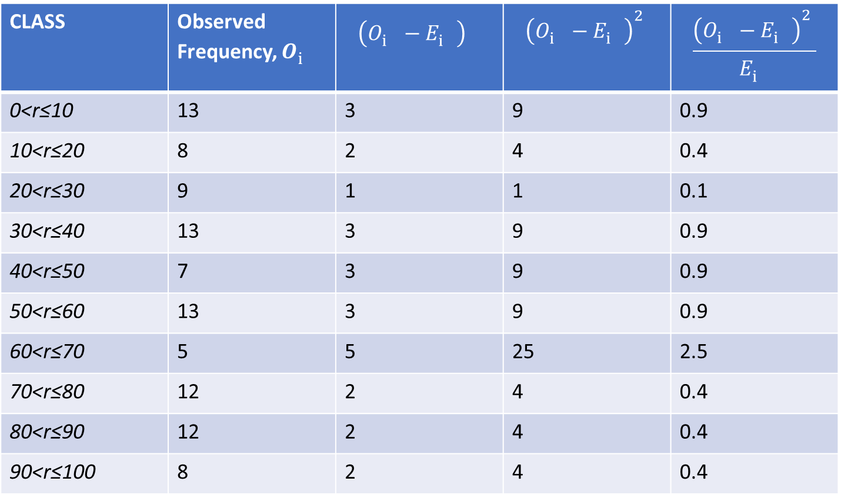
RANDOM NUMBERS
ANSWER
CLASS | Observed Frequency, $O_{i}^{}$ | $${\left(O_{i}^{}−E_{i}^{}\right)}_{}^{}$$ | $${\left(O_{i}^{}−E_{i}^{}\right)}_{}^{2}$$ | $$\frac{{\left(O_{i}^{}−E_{i}^{}\right)}_{}^{2}}{E_{i}^{}}$$
0<r≤10 | 13 | 3 | 9 | 0.9
10<r≤20 | 8 | 2 | 4 | 0.4
20<r≤30 | 9 | 1 | 1 | 0.1
30<r≤40 | 13 | 3 | 9 | 0.9
40<r≤50 | 7 | 3 | 9 | 0.9
50<r≤60 | 13 | 3 | 9 | 0.9
60<r≤70 | 5 | 5 | 25 | 2.5
70<r≤80 | 12 | 2 | 4 | 0.4
80<r≤90 | 12 | 2 | 4 | 0.4
90<r≤100 | 8 | 2 | 4 | 0.4
Here,
Number of classes = n
Total number of observations = N
Expected frequency, $E_{i}^{}$= (N/n)
= (100/10)
= 10
Total = 7.8

Slide 8
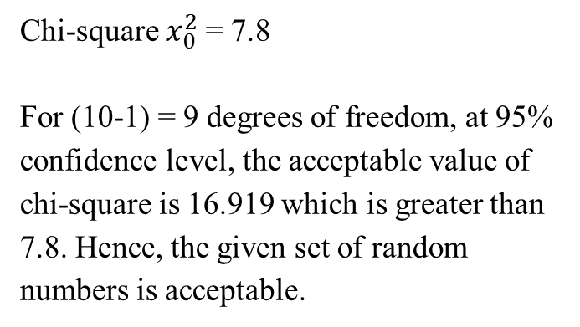
RANDOM NUMBERS
Chi-square $x_{0}^{2}$= 7.8
For (10-1) = 9 degrees of freedom, at 95% confidence level, the acceptable value of chi-square is 16.919 which is greater than 7.8. Hence, the given set of random numbers is acceptable.
Chi-Square Critical values
Degrees of freedom | α = 0.20 | α = 0.10 | α = 0.05 | α = 0.02
1 | 1.642 | 2.706 | 3.841 | 5.412
2 | 3.219 | 4.605 | 5.991 | 7.824
3 | 4.642 | 6.251 | 7.815 | 9.837
4 | 5.989 | 7.779 | 9.448 | 11.668
5 | 7.289 | 9.239 | 11.070 | 13.388
6 | 8.558 | 10.645 | 12.592 | 15.033
7 | 9.803 | 12.017 | 14.067 | 16.622
8 | 11.030 | 13.362 | 15.507 | 18.168
9 | 12.242 | 14.684 | 16.919 | 19.679
10 | 13.442 | 15.987 | 18.307 | 21.161
11 | 14.631 | 17.275 | 19.675 | 22.618
12 | 15.812 | 18.549 | 21.026 | 24.054
13 | 16.985 | 19.812 | 22.362 | 25.472

